Slide 1
Recurring Bug Fixes in Object-Oriented Programs
Tung Thanh Nguyen, Hoan Anh Nguyen, Nam H. Pham, Jafar Al-Kofahi, Tien N. Nguyen
Presenter
Wasique Islam Shafin (40304330)
0
Paper Presentation

Slide 2
Introduction & Motivation
Previous studies confirms existence of recurring bug fixes where a bug-fixing change is recurring if repeated identically or with slight modifications across multiple code fragments or revisions.
But it created more questions
- Why, where and how often do these changes reoccur?
- How can they be characterized and recognized?
- How to help developers fix them effectively?
1

Slide 3
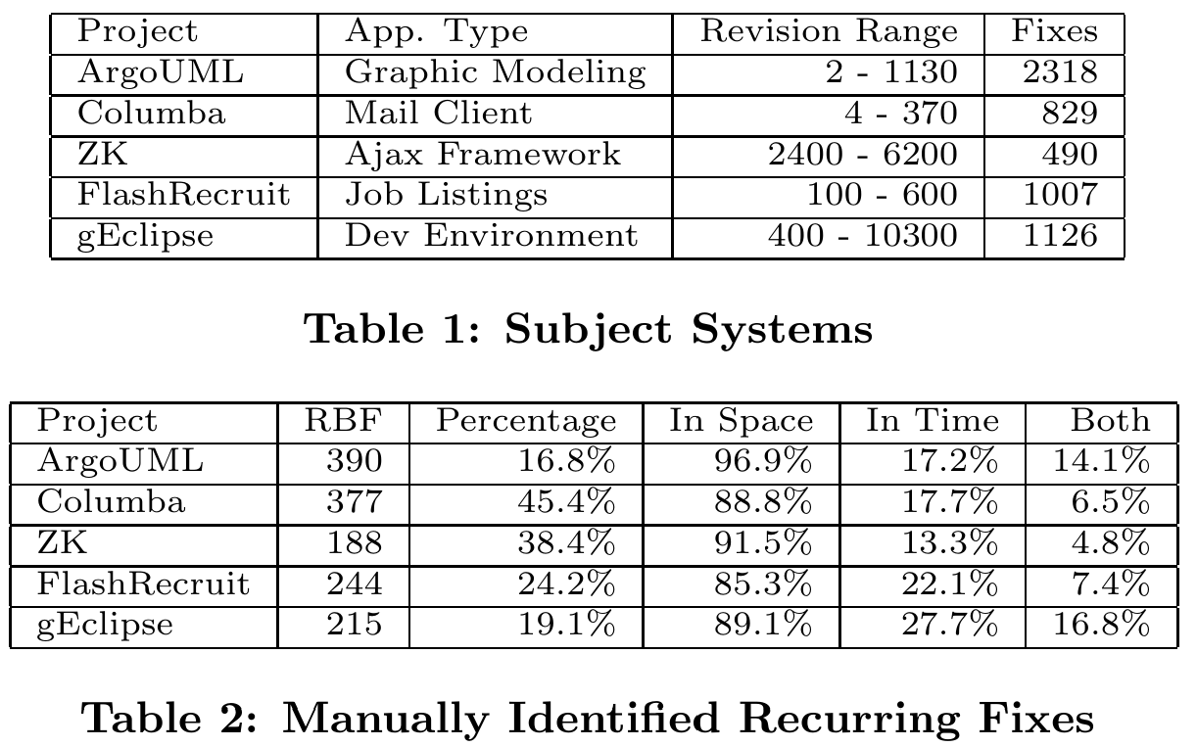
Dataset
The dataset comes from seven experienced programmers who manually reviewed bug fixes in around a thousand fixing revisions across five popular open-source projects with thousands of fixing changes.
Found high concentration recurring fixes in code peers
2

Slide 4
Methodology I
Identify Code Peers in OOP
Recognize Recurring Bug Fixes
Recommend Fixing Changes from historical bug fixes
code peers are the code units (e.g. methods, classes) having similar object interactions
Finds Peer candidates for recommendations
3

Slide 5
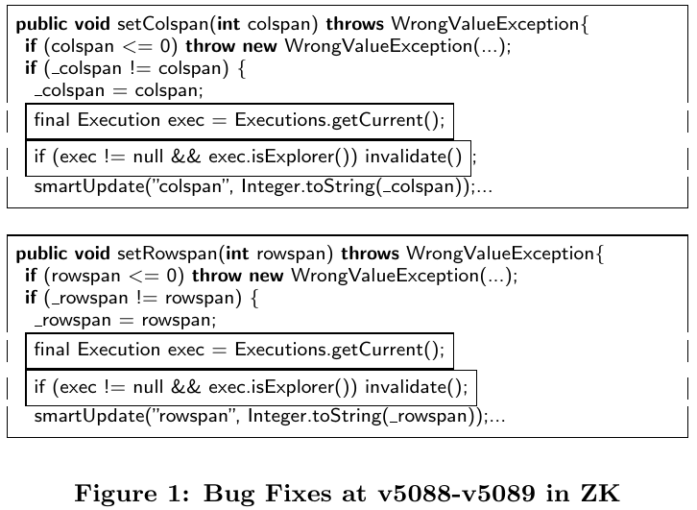
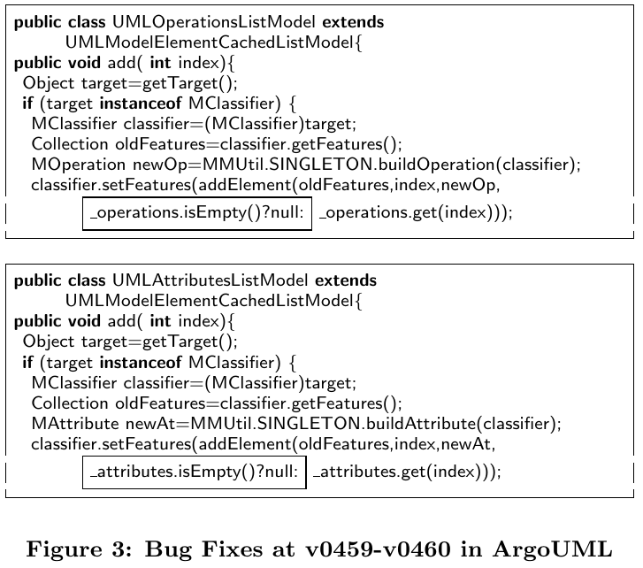
Example Code Peer
4

Slide 6
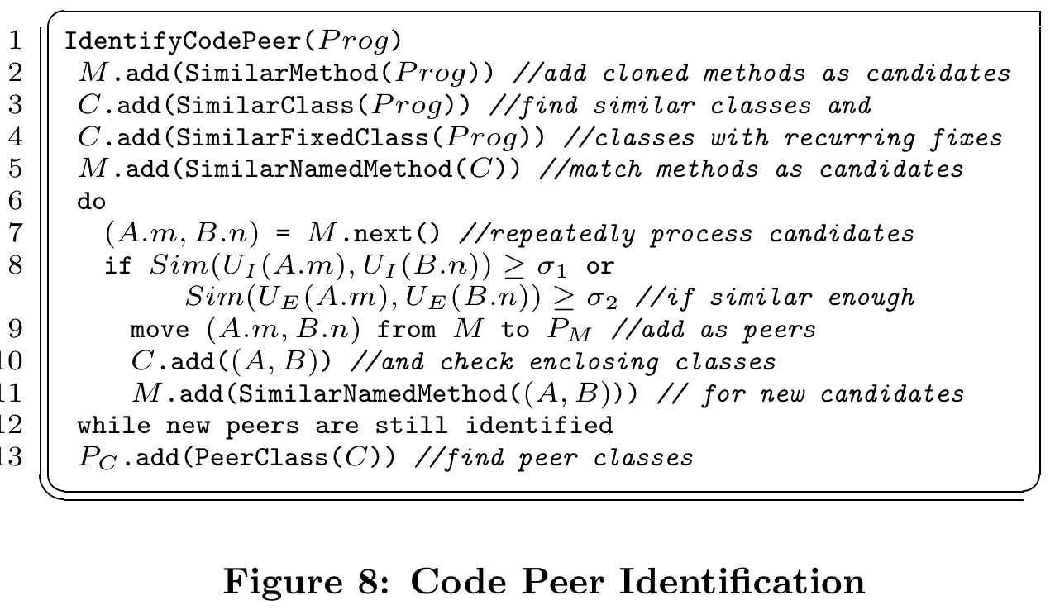
Methodology II
5

Slide 7
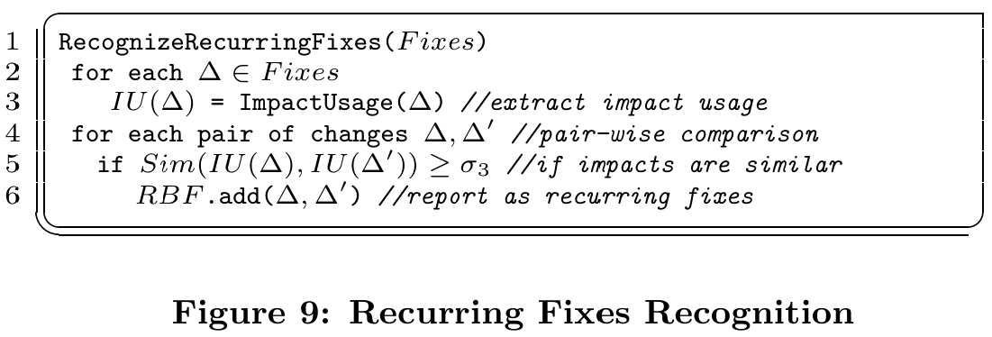
Methodology III
6

Slide 8
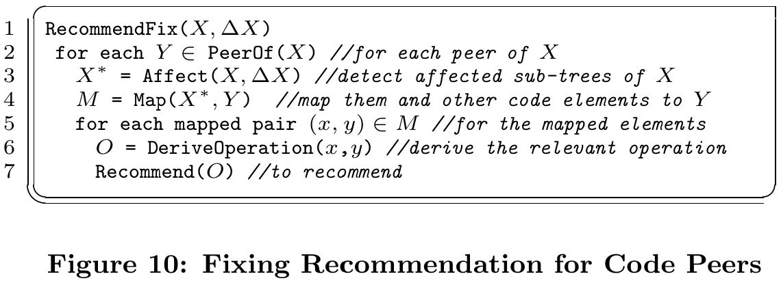
Methodology IV
7

Slide 9
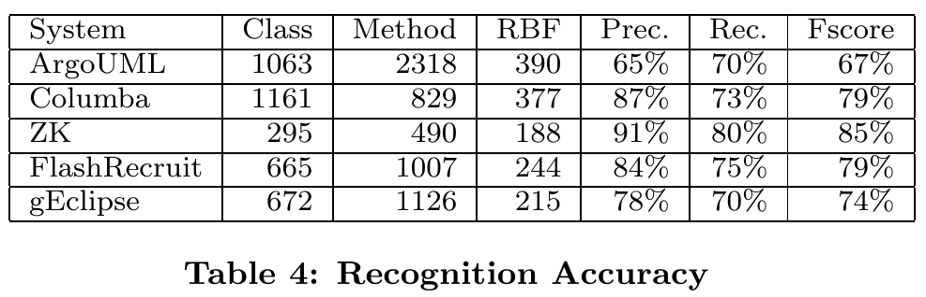
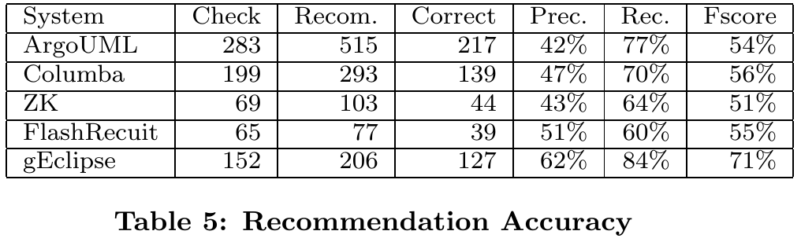
Evaluation Results
Recurring Fix Recognition:
Precision: 81%
Recall: 74%
Fixing Recommendation:
Recall: 71%
Precision: 49%
8

Slide 10
Contributions
An Empirical study on Recurring Bug Fixes
New concepts, rules and algorithms to find, and fix recurring bugs
An Empirical Evaluation validating their approach
9

Slide 11
Limitations
Unreported Bug Fixes may remain in the dataset
Bugs may be Human biased when checking for what constitutes a bug
10

Slide 12
Conclusion
Investigated Recurring bug-fixing changes
Found a high amount of these bug fixes occur in code peers
Developed novel algorithms to find and fix such recurring bug-fixes
11

Slide 13
Thank You
12

